Slide 1
WEEK 4
HCP and Patient Segmentation
From 6,000 prescribers and one call plan to five behaviors marketing can act on —
and the three tests a segmentation must pass before anyone builds a plan on it.
Andi Cupallari · Applied Data Science and AI in Pharma Commercial · Fall 2026 · Monday, October 5
Week 4 — HCP and Patient Segmentation · Pharma DS&AI · Fall 2026
1 / 39
Notes:
Third coding night. One notebook (GLUCOREN, 6,000 HCPs, 18 months, 20,000 patients) run in two halves around the break. Week 3 answered 'how much did the spend do'; tonight is 'to whom, and why the same thing to all of them'. No homework released tonight — Homework 1 is due next Monday; the term-project data plan is due tonight.

Slide 2
AGENDA
0
Recap, data plans, and the Marketing Director's question
Deciles vs. behavior vs. needs — 15 min
1
What a segmentation is for
Three kinds, three tests, and the persona bridge — 15 min
2
Features from claims/Rx — live, part 1
Four families · feature hygiene · the decile baseline · k-means and choosing k — 40 min
3
Evaluation — live, part 2
Stability · separation · interpretability · grading against the truth · two-stage — 30 min
4
Supervised segmentation and the bridge to NBA
Predict growth, then rank: Champions / Loyalists / Churners — 15 min
5
Personas, activation, and patient segmentation
Segment cards · the segment × channel matrix · patients and governance — 20 min
6
Pitfalls, in-class exercise, next week
Five ways segmentations fail · name the segments · Week 5 is NBA — 15 min
Week 4 — HCP and Patient Segmentation · Pharma DS&AI · Fall 2026
2 / 39

Slide 3
00
Recap and the Marketing Director's question
Three weeks of 'what the manufacturer can see and what its spend did'. Tonight: to whom?
Week 4 — HCP and Patient Segmentation · Pharma DS&AI · Fall 2026
3 / 39

Slide 4
0 · RECAP
Three things from Weeks 1–3 that tonight depends on
The segmentation inherits all three — and Week 5's Next Best Action engine inherits the segmentation
1
The payer sits between the HCP and the fill
2
HCP-level Rx is projected and longitudinal
3
Detailing works — on average
▸ Week 1: an HCP can choose GLUCOREN and the pharmacy can still reject the claim.
▸ Tonight it is a feature — the reject rate — and it turns out to be the one that predicts churn.
▸ Week 2: Xponent-style HCP TRx/NBRx, plus patient-level claims for switching and journeys.
▸ Every feature tonight is built from those two files the Week 2 way.
▸ Week 3: the MMM said HCP detailing sits on the steep part of its curve.
▸ Average over 6,000 HCPs. Tonight: for whom? The call plan gives decile 10 the same frequency whether share is 1% or 42%.
Data plans (one page) are due tonight — hand them in before the break. Homework 1 (MMM) is due Monday, October 12.
Week 4 — HCP and Patient Segmentation · Pharma DS&AI · Fall 2026
4 / 39
Notes:
Collect data plans. Bridge from Week 3: 'detailing has a marginal ROI of X' is an average. The whole point of tonight is that the average hides five different prescribers.

Slide 5
0 · THE QUESTION
The Marketing Director's question — asked before every brand-plan cycle
GLUCOREN, three years after launch, 6,000 targeted prescribers
“We have 6,000 targeted prescribers, one call plan, and one message. Who are they, really —
and why are we saying the same thing to all of them?”
What we owe back
What we will not pretend
▸ A handful of segments, each a behavior a marketer can recognize
▸ Evidence that the segments are stable (the field's lists will not reshuffle at the next refresh)
▸ A different play per segment — channel, frequency, message — and the trigger that moves an HCP between them
▸ The same for patients (with the governance that patient data demands)
▸ That k-means found 'the' segments — it found one partition among many that fit about as well
▸ That a silhouette of 0.23 is bad (it is normal for behavioral data) or that 0.6 would make marketing happy
▸ That a segment name is a fact rather than a hypothesis about a behavior
▸ That segmenting patients is the same job as segmenting HCPs
Week 4 — HCP and Patient Segmentation · Pharma DS&AI · Fall 2026
5 / 39

Slide 6
0 · THREE KINDS
Decile, behavioral, needs-based — the three segmentations every brand has
Tonight is behavioral. The right answer in industry is 'decile for volume, behavior for the play, needs for the message'.
 | Decile (volume) segmentation | Behavioral segmentation | Needs-based (attitudinal) segmentation
What it is | Rank HCPs by category or brand volume; cut into ten equal-count groups | Cluster HCPs on what they do: share, trend, NBRx, switching, patient mix, channel response | Cluster on what they believe and need: surveyed attitudes, barriers, information needs
Data | One column of Rx data | Rx panel + claims + CRM/digital activity (tonight's four families) | Primary market research (n = 300–800), then a typing tool to score the universe
Answers | How big? | How big, how loyal, moving which way, reachable how? | Why? What would change their mind?
Refresh | Monthly, automatically | Quarterly or semi-annually; must be stable across refreshes | Every 2–3 years; expensive
Blind to | Everything but volume | Motivation; anything not in the data (the 'why') | Small samples; the typing tool never reproduces the segments cleanly
Used for | Call frequency, target lists, incentive comp | Channel mix, cadence, sequencing; the NBA context | Creative and messaging strategy; persona language
Week 4 — HCP and Patient Segmentation · Pharma DS&AI · Fall 2026
6 / 39
Notes:
Interview question: 'we already have deciles, why do we need segmentation?' Answer with the decile-10 range on the next section's chart. The needs-based column is what the agency will ask for; explain why the typing tool is the weak link.

Slide 7
01
What a segmentation is for
A segmentation is a decision artifact, not a model score. Three tests decide whether it survives contact with a brand team.
Week 4 — HCP and Patient Segmentation · Pharma DS&AI · Fall 2026
7 / 39

Slide 8
1 · THE THREE TESTS
Stability, separation, commercial interpretability — in that order
A segmentation that fails test 1 is dangerous; one that fails test 3 is useless
1
2
3
3 · Commercial interpretability
1 · Stability
2 · Separation
▸ Check stability:
  Re-run on a bootstrap resample,
  on another seed,
  on 11 months instead of 12
  Do the same HCPs land together?
▸ Why first: an unstable segmentation reshuffles the field's target lists every refresh. The fastest way to lose the sales force.
▸ Silhouette per cluster (−1…1), Davies–Bouldin, Calinski–Harabasz.
▸ Behavioral data gives 0.2–0.35 overall. That is normal.
▸ Why it matters: one cluster with a silhouette near zero and many negative points is a leftover, not a behavior — merge it or drop the feature that made it.
▸ Each segment: a one-line behavior, a size, a value (brand TRx now and headroom), a reachability (a channel that works), and a different play.
▸ If two segments get the same play, merge them.
▸ Why last: you can only judge it once 1 and 2 are settled — naming an unstable cluster is fiction.
Week 4 — HCP and Patient Segmentation · Pharma DS&AI · Fall 2026
8 / 39
Notes:
These three come back as notebook section 7. Say it now: silhouette 0.23 tonight is not a problem. A stability ARI of 0.6 would be.

Slide 9
1 · THE PIPELINE
From files to a plan — what tonight's notebook does, end to end
The same steps as a real engagement
HCP master + Rx panel + activity
Feature engineering (4 families)
Hygiene · log · winsorize · scale
Cluster (k-means) · choose k
Evaluate: 3 tests
Profile · name · persona
Activation matrix → NBA
Decisions you will have to defend
Feature window vs outcome window
▸ Which features, and which family gets how much weight (scaling is a weighting decision)
▸ Rates over counts (why?), and where a rate's denominator is too small to trust
▸ k — with statistics, stability, and
  'can marketing run k plays?'
▸ One stage or two (value tier first, behavior within)
▸ Unsupervised (behavior) vs supervised (outcome) — or, usually, both
▸ Months 1–12 (2025): every segmentation feature is built here.
▸ Months 13–18 (Jan–Jun 2026): used only to see whether a December segmentation predicted what happened next.
▸ Outcome data in the features = leakage. This is the segmentation version of Week 3's hold-out.
Week 4 — HCP and Patient Segmentation · Pharma DS&AI · Fall 2026
9 / 39

Slide 10
02
Features from claims/Rx — live, part 1
Week 4 — HCP and Patient Segmentation · Pharma DS&AI · Fall 2026
10 / 39

Slide 11
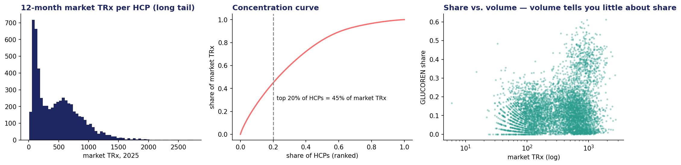
2 · THE DATA
GLUCOREN: 6,000 targeted HCPs, 18 months, 20,000 patients
File | Grain | What it holds
glucoren_hcp_master.csv | HCP (6,000) | Specialty, region, setting, tenure; patient mix (payer shares, age, CV comorbidity); GLUCOREN pharmacy-reject rate
glucoren_hcp_monthly.csv | HCP × month (108,000) | Market TRx, GLUCOREN TRx/NBRx, competitor TRx, switches in/out, rep calls, samples, emails sent/opened, web visits
glucoren_patients.csv | Patient (20,000) | Dx-to-first-Rx, months on therapy, prior lines, PDC, refill gaps, switches, copay, PSP, portal, comorbidity, ER visits, discontinued
45%
412 / 29
4.9 → 21.9
of category TRx from the top 20% of HCPs
median market / GLUCOREN TRx per HCP-year
calls per HCP-year, lowest → highest volume quintile
Week 4 — HCP and Patient Segmentation · Pharma DS&AI · Fall 2026
11 / 39

Slide 12
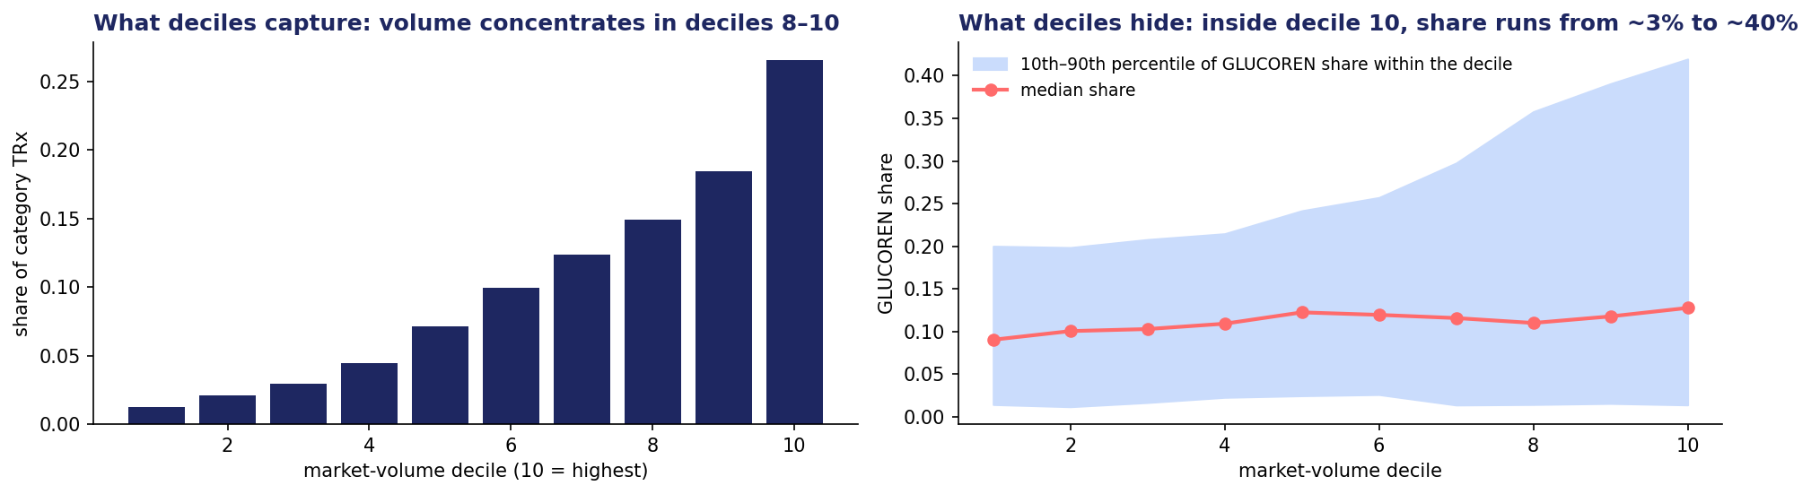
2 · THE DECILE BASELINE
What deciles capture — and what they hide
Same call frequency for every HCP in decile 10, whether GLUCOREN share is 1% or 42%
Left: deciles 8–10 write 60% of the category — that is why deciles exist and why they will not go away. Right: inside every decile, brand share runs from near zero to a third or more. Deciles answer 'how big'; a plan needs 'how big, how loyal, moving which way, reachable how'.
Keep the decile as the volume axis. Put the behavior next to it.
Week 4 — HCP and Patient Segmentation · Pharma DS&AI · Fall 2026
12 / 39

Slide 13
2 · FOUR FAMILIES
Feature engineering from claims/Rx — the four families the syllabus names
One row per HCP from the 12 feature months; log the counts, prefer rates, and know where each column comes from in a real brand
Family | Tonight's features | Source in a real brand | Watch out for
Writing behavior | Market volume · GLUCOREN share · share trend (H2 − H1) · NBRx share of brand TRx | Rx panel (Xponent-style projection, Week 2) | Volume re-encodes decile; trend on a small base is noise
Patient mix | % Medicare · mean patient age · % CV comorbidity · GLUCOREN pharmacy-reject rate | Claims (payer of record, Dx codes); formulary / reject data (Week 2, category 4) | Reject rate is an access signal, not a behavior — but it predicts behavior
Switching | Switch-in rate (share of NBRx from a competitor) · switch-out rate | Longitudinal patient-level Rx (Week 2 LOT logic) | Switch-out rate on 5 brand TRx is a coin flip (next slide)
Channel response | Calls received · email open rate · web visits · call response (corr. of brand TRx with last month's calls) | CRM, marketing automation, web analytics | Activity ≠ response; 'calls' is a decision the brand made
Interview answer to 'what features would you use?': name the four families, then name one feature per family and where it comes from.
Week 4 — HCP and Patient Segmentation · Pharma DS&AI · Fall 2026
13 / 39

Slide 14
2 · HYGIENE
Feature hygiene — the step that separates a segmentation from a scatter of outliers
Notebook §4b: k-means on the raw features builds a 72-HCP cluster out of one noisy rate
What happened
The fixes, in order of preference
▸ k = 5 on all 14 features: cluster sizes 72 / 806 / 1,303 / 1,453 / 2,366.
▸ The 72: median 7 brand TRx, switch-out rate 0.17 (universe 99th percentile: 0.12). One patient switching away = a 14% 'rate'.
▸ Std of switch-out rate: 0.047 below 10 brand TRx vs 0.012 above 100 — same mean, four times the spread.
▸ The k-means objective prefers this solution (lower inertia). More restarts make it worse, not better.
▸ Drop the feature when its only information is the denominator (switch-out; switch-in carries the switching signal).
▸ Shrink the rate toward the universe mean with a Bayesian/empirical-Bayes prior weighted by the denominator.
▸ Winsorize every rate at the 1st/99th percentile (tonight, for the rest).
▸ Log-transform counts (volume, calls, visits) — Pareto-shaped columns dominate Euclidean distance.
▸ Re-check the correlation matrix: a pair above |0.5| is one behavior counted twice.
Week 4 — HCP and Patient Segmentation · Pharma DS&AI · Fall 2026
14 / 39
Notes:
This is the pharma-specific lesson of the feature section. Every HCP-level rate has a denominator problem because most HCPs write very little of any one brand. Ask: which other feature tonight has the same issue? (NBRx share, call response.)

Slide 15
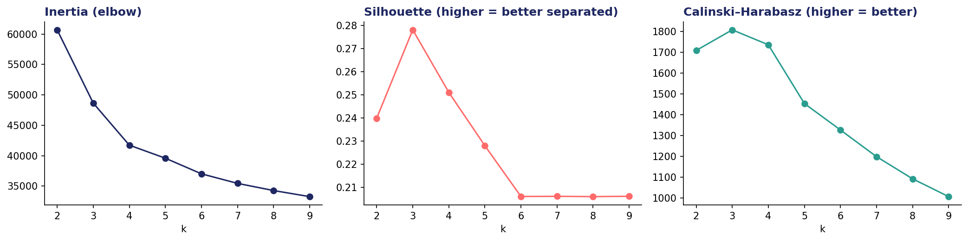
2 · CHOOSING k
Choosing k — three statistics, then the commercial test
Silhouette and Calinski–Harabasz peak at k = 3; the elbow is around 4–5; marketing can run five plays
Silhouette peaks at 3 (0.28) and is 0.23 at 5 — the statistics prefer fewer, rounder clusters than the business needs. Inertia keeps falling; the elbow is a judgement. GMM's BIC keeps improving to 8 because it rewards fitting the long tails.
The commercial test settles it: 4–6 segments is the range a brand team can build distinct plays for. Tonight k = 5, then we check whether 5 survives the stability test — and whether one stage is enough.
Week 4 — HCP and Patient Segmentation · Pharma DS&AI · Fall 2026
15 / 39
Notes:
Do not let the room pick k from the silhouette alone. Ask: what would marketing do with 3 segments? With 9?

Slide 16
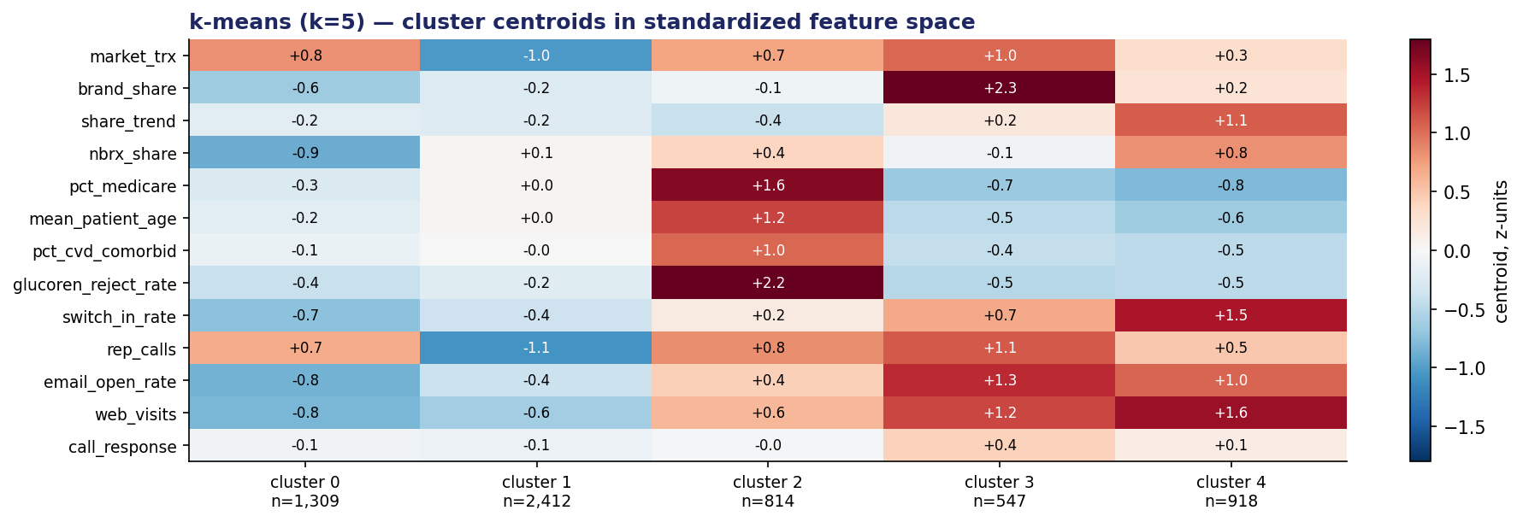
2 · THE PROFILE
k = 5 — the profile heatmap, read family by family
Centroids in standardized space; one sentence per cluster before any name
One sentence each
▸ 0 (n=1,309): big writers, 6% share, no NBRx, no digital — someone else's brand.
▸ 1 (n=2,412): small writers, few calls, average share — the long tail.
▸ 2 (n=814): Medicare-heavy, reject rate 2.2σ above — they try and the pharmacy says no.
▸ 3 (n=547): 38% share, most calls, most responsive — the brand's core.
▸ 4 (n=918): share rising 8 pts, half of NBRx switched in, most digital — the movers.
Segment 3 is 9% of HCPs and 45% of brand TRx. Segment 1 is 40% of HCPs and 8% of TRx — still a segment; it just needs a cheap play.
Week 4 — HCP and Patient Segmentation · Pharma DS&AI · Fall 2026
16 / 39

Slide 17
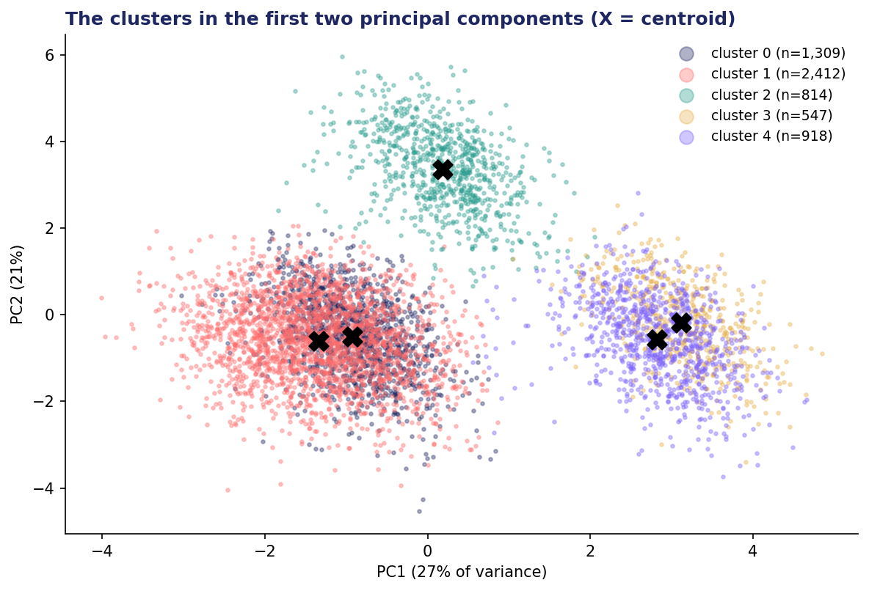
2 · IN TWO DIMENSIONS
The clusters in the first two principal components
PC1 = engagement and share (digital, email, switch-in, share); PC2 = the patient-mix / access axis (Medicare, age, comorbidity, reject rate)
What the picture is for
▸ Sanity, not proof: are these islands or a continuum sliced five ways? Mostly the latter — that is what behavioral data looks like.
▸ The access segment (2) separates along PC2, not PC1: it is defined by patient mix, not by engagement. That is why a decile or an engagement score never finds it.
▸ The core (3) and the movers (4) overlap on PC1 — the two-stage step later separates them on trend and NBRx.
▸ UMAP (notebook §6, optional) gives a prettier picture and the same conclusion.
Week 4 — HCP and Patient Segmentation · Pharma DS&AI · Fall 2026
17 / 39

Slide 18
03
Evaluation — live, part 2
Alternatives, the three tests, grading against the truth, and clustering twice.
Week 4 — HCP and Patient Segmentation · Pharma DS&AI · Fall 2026
18 / 39

Slide 19
3 · ALTERNATIVES
Four alternatives to k-means — and when each earns its place
All on tonight's features; agreement with k-means measured by adjusted Rand index (ARI)
Method | What changes | Tonight's result | When it matters in pharma
Gaussian mixture (GMM) | Soft membership; ellipsoidal clusters; BIC for k | ARI vs k-means 0.48; only 0.2% of HCPs below 70% membership probability | Boundary HCPs get a probability, not a label — the NBA layer next week can use it
Hierarchical (Ward) | Dendrogram; nested segments; no k up front | ARI vs k-means 0.96 on a 3,000-HCP sample | Brand teams love nested segmentations ('high-value → loyal / contested')
HDBSCAN | Density-based; leaves noise unassigned; no k | 3 dense clusters; 39% of HCPs unassigned; ARI 0.66 on the assigned | Says 'no clear behavior' out loud instead of forcing it — honest, hard to sell
UMAP | Non-linear 2-D map for looking | Same islands as PCA, sharper | Presentations; checking whether clusters are real
Industry answer: k-means (or Ward) for the segmentation everyone has to understand; a GMM or a supervised score on top for the decisions that need a probability.
Week 4 — HCP and Patient Segmentation · Pharma DS&AI · Fall 2026
19 / 39

Slide 20
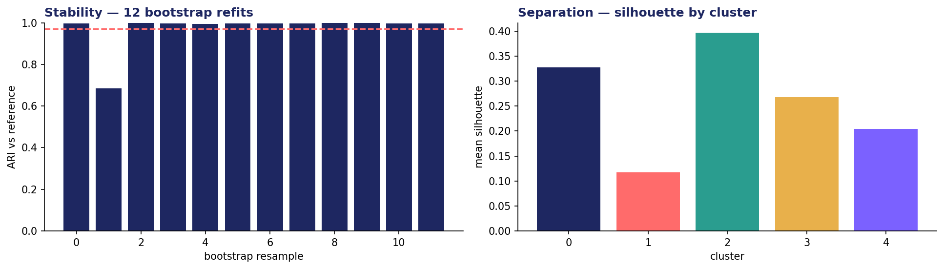
3 · STABILITY & SEPARATION
Test 1 and test 2 — the numbers tonight's segmentation has to show
Notebook §7: 12 bootstrap refits, 5 seeds, an 11-month feature window; silhouette by cluster
Stability: bootstrap ARI mean 0.97, matched per-HCP agreement 97% — but one resample and one seed land at 0.69. That is the run where k-means swapped the movers into the core. Report the minimum, not just the mean; it tells you which boundary is fragile.
Separation: overall silhouette 0.23; clusters 0, 2 and 3 are well formed (0.27–0.40); the long tail (1) is 0.12 with 8% negative — a leftover by construction, and fine as long as its play is 'cheap and digital'.
Week 4 — HCP and Patient Segmentation · Pharma DS&AI · Fall 2026
20 / 39
Notes:
The 0.685 run is the teaching moment: the segmentation is stable except at one boundary — core vs movers. That is exactly where stage 2 goes.

Slide 21
3 · THE CARD TABLE
Test 3 — the segment card table: who, worth, reach
Read across a row: who they are → what they are worth → how to reach them. If two rows get the same play, merge them.
Cluster | HCPs | % of brand TRx | Share | Trend | Headroom (TRx to 35%) | Calls / HCP | Calls per brand TRx | Call resp. | Email open | Web | Medicare | Reject
0 · entrenched | 1,309 | 15% | 6% | +0.6 pt | 292k | 19.3 | 0.39 | 0.01 | 14% | 6 | 35% | 7%
1 · long tail | 2,412 | 8% | 11% | +0.3 | 80k | 4.9 | 0.33 | 0.00 | 20% | 7 | 39% | 9%
2 · access-constrained | 814 | 16% | 12% | −0.6 | 128k | 21.7 | 0.26 | 0.03 | 30% | 21 | 60% | 31%
3 · core | 547 | 45% | 38% | +2.8 | 0 | 26.7 | 0.07 | 0.17 | 42% | 36 | 29% | 6%
4 · movers | 918 | 16% | 16% | +7.7 | 84k | 16.8 | 0.22 | 0.08 | 38% | 49 | 28% | 7%
Headroom is a planning convention (TRx if the segment reached a 35% share ceiling), not a forecast — but it ranks the segments the way a brand plan does: the entrenched 1,309 hold the most headroom and get the least response per call. The core has no headroom and the most calls.
Calls per brand TRx is the cheapest 'are we over-serving' check a segmentation can produce: 0.39 for the entrenched vs 0.07 for the core.
Week 4 — HCP and Patient Segmentation · Pharma DS&AI · Fall 2026
21 / 39

Slide 22
3 · GRADE VS TRUTH
Because the data is synthetic — the planted behaviors vs the clusters
Notebook §8. This never exists in a real engagement; use it to learn what k-means gets wrong and why
Planted behavior | → cluster 0 | 1 | 2 | 3 | 4
Access-Constrained (809) | 0 | 0 | 809 | 1 | 2
Brand Champions (537) | 0 | 0 | 0 | 533 | 4
Entrenched Competitor (1,293) | 1,287 | 2 | 0 | 0 | 4
Growers (909) | 0 | 0 | 0 | 13 | 896
Occasional (2,449) | 22 | 2,410 | 5 | 0 | 12
0.974
0.48
ARI, k-means k=5 vs planted
ARI, GMM k=5 vs planted
Why it worked — and why it usually does not
▸ After hygiene, five planted behaviors that differ on different feature families are almost perfectly recovered. Real behaviors overlap far more.
▸ GMM fit the long tails instead of the behaviors (BIC kept improving to k = 8). More flexible ≠ more right.
▸ The 13 Growers in cluster 3 and the 0.69 bootstrap run are the same boundary: the movers on their way to becoming the core.
Before hygiene (raw features) the ARI was 0.89 and a 72-HCP junk cluster existed. The single biggest accuracy gain tonight came from dropping one column — not from the algorithm.
Week 4 — HCP and Patient Segmentation · Pharma DS&AI · Fall 2026
22 / 39

Slide 23
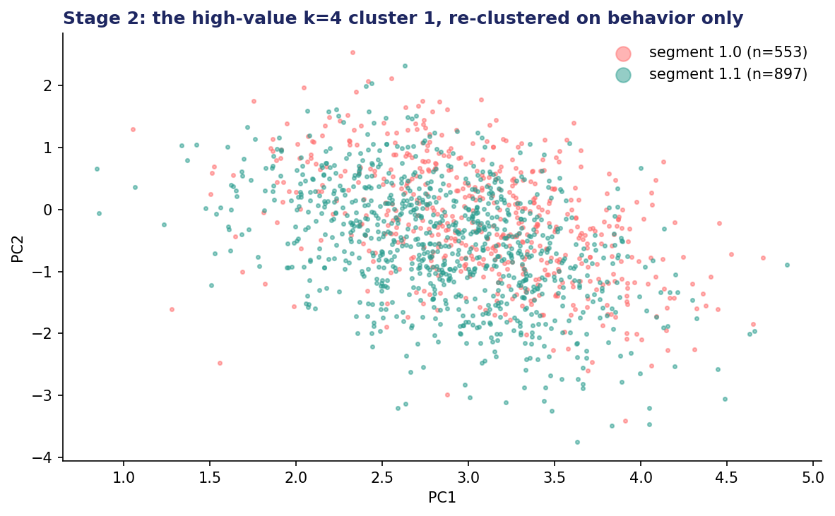
3 · TWO STAGES
Practitioners cluster twice — value tier first, behavior within
k is never known. Stop at the elbow (k = 4) and the highest-value cluster holds 1,450 HCPs, 61% of brand TRx — and two behaviors.
Stage 2 on the high-value cluster, behavior features only
▸ Silhouette by k: 2 → 0.34, 3 → 0.22, 4 → 0.20. Two behaviors.
▸ 1.0 (553): 932 market TRx, 38% share, trend +2.7 pt, call response 0.16 — the core.
▸ 1.1 (897): 487 market TRx, 16% share, trend +7.8 pt, 48% NBRx share, 54% switched in, 51 web visits — the movers.
▸ ARI vs planted: k = 4 single stage 0.92 → two-stage 0.98 (k = 5 single stage 0.97).
▸ Why it is the industry default: a brand team can explain 'value tier, then behavior' in one sentence, and the value tier is the decile they already have.
Week 4 — HCP and Patient Segmentation · Pharma DS&AI · Fall 2026
23 / 39
Notes:
Two-stage is also how you reconcile with the decile: stage 1 is effectively the volume/value split, stage 2 is the behavior. Sales ops keeps its deciles; marketing gets its behaviors; the two agree by construction.

Slide 24
04
Supervised segmentation
Predict growth, then rank. A different question from 'who behaves alike' — and the bridge to Next Best Action.
Week 4 — HCP and Patient Segmentation · Pharma DS&AI · Fall 2026
24 / 39

Slide 25
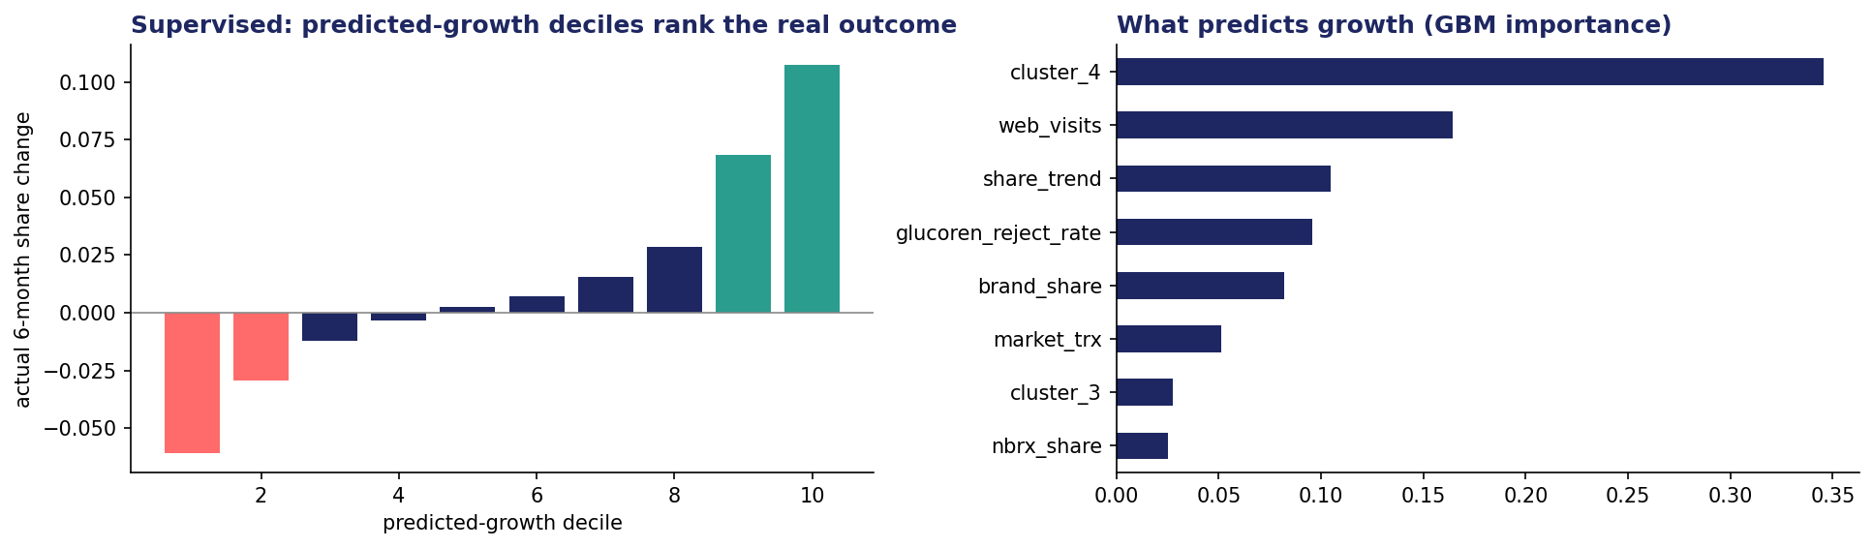
4 · PREDICT, THEN RANK
Champions / Loyalists / Churners
Label = change in GLUCOREN share over months 13–18; features from months 1–12; 30% of HCPs held out
Hold-out R² 0.42 — share change at HCP level is noisy, and that is fine: the deciles of predicted growth rank the real outcome almost monotonically (decile 10: +10.8 share points; decile 1: −6.1). Ranking is what a target list needs.
What predicts growth: being a mover (cluster 4), web engagement, the share trend — and the pharmacy-reject rate, which predicts decline. The model just found the hidden churn driver: access.
Week 4 — HCP and Patient Segmentation · Pharma DS&AI · Fall 2026
25 / 39

Slide 26
4 · TWO QUESTIONS
Behavior is the context; the growth score is the priority
Unsupervised segment (rows) × supervised outcome group (share of HCPs in each)
Two-stage segment | Champions (pred. deciles 9–10) | Loyalists / stable | Churn risk (deciles 1–2) | What the cross-tab tells the brand
0 · long tail | 2% | 79% | 19% | Cheap digital play; a churn flag here is low-value — do not send a rep
1.0 · core | 45% | 54% | 1% | Protect and grow; almost no churn risk — frequency can come down
1.1 · movers | 100% | 0% | 0% | Every one is a predicted grower — sequence them, do not saturate them
2 · access-constrained | 0% | 14% | 86% | Churn is not a messaging problem; hand the list to market access
3 · entrenched | 0% | 97% | 3% | Stable and low share; test a different message, do not add calls
The lesson
A 'churn risk' HCP inside the entrenched segment and one inside the access segment need different conversations. Next week's NBA engine takes both columns: the segment as the context, the score as the priority.
Week 4 — HCP and Patient Segmentation · Pharma DS&AI · Fall 2026
26 / 39

Slide 27
05
Personas, activation, and patients
Segment cards, the segment × channel matrix, and the same machinery on journey features — with governance.
Week 4 — HCP and Patient Segmentation · Pharma DS&AI · Fall 2026
27 / 39

Slide 28
5 · PERSONAS
From cluster numbers to personas the agency and the field can use
Name the behavior, never the number. The exercise asks you to name tonight's five; here is the shape of a card.
The Core
The Movers
The Access-Constrained
The Entrenched
The Long Tail
▸ Who: 9% of HCPs · 45% of brand TRx · 38% share, rising · most responsive to calls (0.17)
▸ Needs: Confidence: outcomes data, peer voice, patient support that makes the next script easy
▸ Play: Protect: keep reps, lower frequency, add peer programs; calls per brand TRx is already 0.07
▸ Exit trigger: Trend turns negative for two quarters → 'at risk core'
▸ Who: 15% · 16% · share 16% rising 8 pts/half-year · half of NBRx switched in · most digital
▸ Needs: Evidence for switching: head-to-head data, access wins, samples at the moment of the switch
▸ Play: Grow: sequence email → web → call around switching triggers; do not saturate
▸ Exit trigger: NBRx share falls below 30% → they have finished moving
▸ Who: 14% · 16% · share 12%, flat · 60% Medicare · 31% of claims rejected · 86% churn risk
▸ Needs: Coverage: prior-auth support, copay programs, formulary status by plan
▸ Play: Fix access before messaging: hand the list to market access; rep carries a coverage message only
▸ Exit trigger: Reject rate falls below 15% → re-segment as a mover
▸ Who: 22% · 15% · share 6%, flat · no NBRx · lowest email/web · 292k TRx of headroom
▸ Needs: A reason to try: a differentiated patient type, a new indication, a peer they trust
▸ Play: Test, do not add calls: 19 calls/year yields 0.39 calls per brand TRx; run a message experiment on a holdout
▸ Exit trigger: First NBRx in a quarter → move to 'movers' watch list
▸ Who: 40% · 8% · 137 market TRx/year · 5 calls · negligible response
▸ Needs: Nothing they have asked for; convenience if anything
▸ Play: Cheapest possible: digital-only, no rep, samples on request
▸ Exit trigger: Volume crosses decile 5 → re-evaluate
Week 4 — HCP and Patient Segmentation · Pharma DS&AI · Fall 2026
28 / 39
Notes:
Every card has an exit trigger. That is the bridge to Week 5: a trigger is an event the NBA engine watches for.

Slide 29
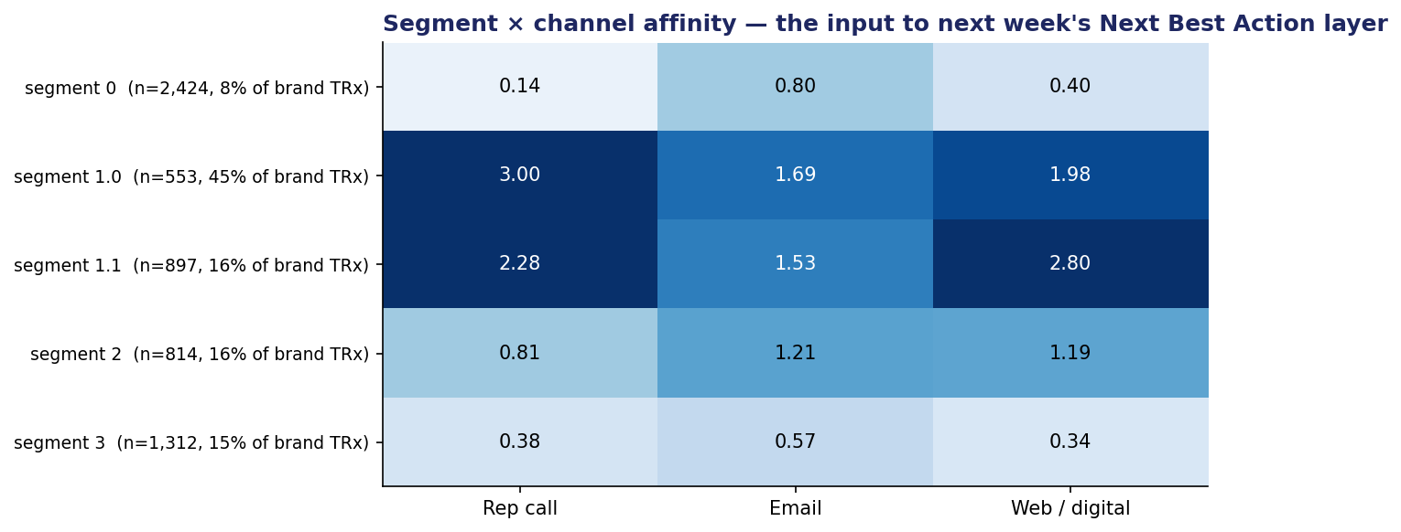
5 · ACTIVATION
The segment × channel affinity matrix — the input to next week's Next Best Action layer
Affinity index = the segment's response measure relative to the universe mean (1.0 = average); two-stage segments
Reading it as a planner
▸ Core (1.0) and movers (1.1) respond to everything — the risk is fatigue, not reach. Frequency caps come from here.
▸ Access (2) is average on email and web, below on calls: the channel is not the problem; the coverage is.
▸ Entrenched (3) and long tail (0) are below average on every channel — more of the same will not move them. Experiments, not frequency.
▸ This matrix + the growth score + the exit triggers = the three inputs Week 5's NBA engine needs.
Week 4 — HCP and Patient Segmentation · Pharma DS&AI · Fall 2026
29 / 39

Slide 30
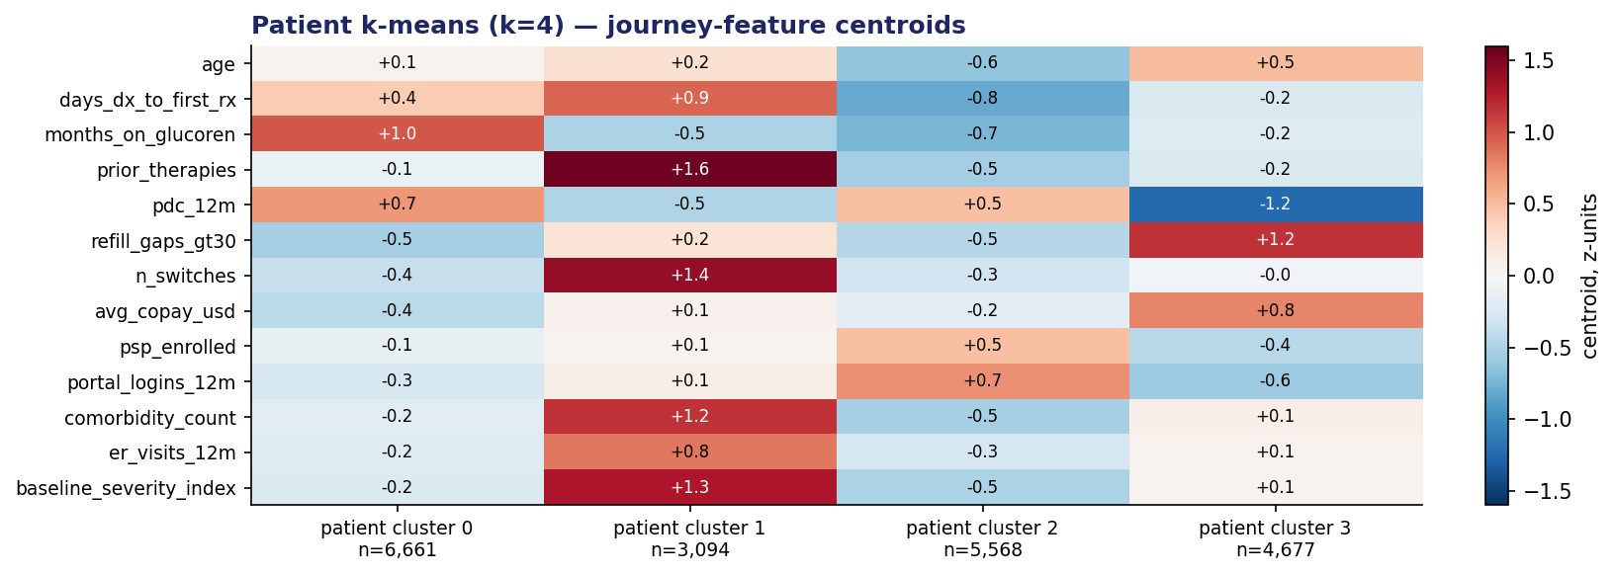
5 · PATIENTS
Patient segmentation — the same machinery on journey features, different questions
20,000 GLUCOREN patients; 13 journey features from claims and the brand's own programs; k = 4; ARI vs planted 0.84
Cluster | Patients | PDC | Copay | Discontinued | Read as
0 | 6,661 | 0.87 | $21 | 5% | Stable long-term
1 | 3,094 | 0.66 | $37 | 27% | Complex late-line (3.3 prior lines, 3.4 comorbidities)
2 | 5,568 | 0.83 | $26 | 8% | Engaged new starters (55% in PSP, 6 portal logins)
3 | 4,677 | 0.51 | $69 | 42% | Cost-sensitive strugglers (69% Medicare Part D)
The questions are different: who is about to stop, who needs affordability routing, which patients need HCP support. The plays are programs, not messages: copay assistance, adherence outreach, nurse support.
Week 4 — HCP and Patient Segmentation · Pharma DS&AI · Fall 2026
30 / 39
Notes:
Cluster 3 is the one the brand can act on cheapest: copay is the driver and a copay program exists. Cluster 1 is the one the HCP needs help with.

Slide 31
5 · GOVERNANCE
A patient segment is an output about a person — governance is part of the model
What the industry's own documents say (verbatim in the reading pack, Part D)
“Outputs such as cohort scores or patient segments are labeled with metadata that restricts downstream use to a specific context and time frame. By making outputs unusable for anything but the intended application, non-reversibility enables robust enforcement of purpose limitation.”
— IQVIA, “Trustworthy AI/ML for Patient Analytics and Research”
Purpose limitation
Data minimization
Who may act on it
▸ Built for adherence support → used for adherence support. Never re-purposed for HCP targeting, never joined back to a prescriber list.
▸ Label every output: purpose, refresh date, owner.
▸ Only features with modeling utility and low re-identification risk. Tonight's file has no names, ZIPs, or dates of birth — and does not need them.
▸ Ages and ER visits are already sensitive in combination.
▸ A patient program (PSP, hub, copay) may. A sales rep may not know a patient's segment. Marketing may see aggregates.
▸ If the segment would embarrass the patient in a settings page, it is not a segment you ship.
Week 4 — HCP and Patient Segmentation · Pharma DS&AI · Fall 2026
31 / 39

Slide 32
06
Pitfalls and pharma realities
Five ways segmentations fail, and what changes when the customer is a physician.
Week 4 — HCP and Patient Segmentation · Pharma DS&AI · Fall 2026
32 / 39

Slide 33
6 · FIVE WAYS IT FAILS
Five ways a segmentation fails in practice
It re-discovers the decile
Volume and calls dominate the distance; the 'segments' are size bands with new names. Check: does one feature explain 80% of between-cluster variance?
It is unstable
Refresh reshuffles 30% of HCPs; the field stops believing the lists. Check: bootstrap ARI < 0.8, or a minimum run far below the mean.
It is not actionable
Seven segments, three plays. Or one segment that is 55% of HCPs. Check: can you write a different play per row of the card table?
It leaks the outcome
Next quarter's growth was in the features; the 'growth segment' is a tautology. Check: feature window ends before anything you will evaluate on.
It confuses activity with response
'Highly engaged' = 'we called them a lot'. Check: does the segment survive when you remove every column the brand controls?
Week 4 — HCP and Patient Segmentation · Pharma DS&AI · Fall 2026
33 / 39

Slide 34
6 · PHARMA QUIRKS
Six things that change when the customer is a physician
Quirk | What it does to the segmentation | What to do
Most HCPs write very little of any one brand | Every rate has a small denominator; outlier clusters appear | Shrink or drop rates; two-stage with a value tier
The brand chose who to call | Activity features encode last year's plan, not response | Use response measures; hold out activity features and check the segments survive
Access varies by patient, not by HCP | The 'behavior' of an access-constrained HCP is the payer's | Reject rate as a feature; the play is market access, not messaging
Institutional prescribers | IDN/health-system HCPs move as a group (formulary, protocols) | Segment accounts as well as individuals; watch setting as a feature
Compliance | No patient-level targeting of HCPs; no promotion off-label; consent for digital | Purpose limitation on every output; legal review of persona language
Refresh cadence | Rx data monthly, segments quarterly, personas yearly | Fix the segment definitions; re-score HCPs; re-cluster only on a schedule
Week 4 — HCP and Patient Segmentation · Pharma DS&AI · Fall 2026
34 / 39

Slide 35
6 · WHEN NOT TO
When a behavioral segmentation is the wrong tool
Recognize these before you spend a quarter on one
The universe is small
The question is 'who will respond'
The question is 'why'
▸ A rare-disease brand with 400 treating physicians does not need five segments
▸ Below ~1,500 HCPs, a decile plus a KOL/non-KOL flag usually beats a cluster.
▸ That is an uplift / next-best-action problem (Week 5), not a segmentation.
▸ Segments are context for a targeting model, not a substitute for one.
▸ Behavioral data cannot tell you what an HCP believes. That needs primary research (needs-based) — and then a typing tool to score the universe, which is its own modeling problem.
Week 4 — HCP and Patient Segmentation · Pharma DS&AI · Fall 2026
35 / 39

Slide 36
07
In-class exercise and next week
Name the segments. Then bring one HCP from each to Week 5.
Week 4 — HCP and Patient Segmentation · Pharma DS&AI · Fall 2026
36 / 39

Slide 37
7 · EXERCISE
In-class exercise — 20 minutes, groups of 3–4
Worksheet in the folder: Week_04_InClass_Exercise.docx
A
Part A · Features by hand (7 min)
B
Part B · Name and activate (8 min)
C
Part C · Pick the tool (5 min)
▸ Six HCPs, twelve months of numbers. Compute share, trend, NBRx share, switch-in rate, email open rate.
▸ Assign each a decile and then a behavior. Where do the two disagree?
▸ The card table from tonight's notebook, unnamed. Name the five segments as behaviors, write one play each, and one exit trigger each.
▸ Then: which two could you merge, and what would you lose?
▸ Six scenarios: decile, behavioral, needs-based, supervised score, HDBSCAN, or 'not a segmentation'.
▸ One sentence of justification each.
Debrief: 5 minutes. The answer key is in the instructor folder.
Week 4 — HCP and Patient Segmentation · Pharma DS&AI · Fall 2026
37 / 39

Slide 38
7 · NEXT WEEK
Next week — Omnichannel, Next Best Action, and patient predictive modeling
Monday, October 12 · Homework 1 due 11:59 PM ET
Before Week 5
Bring
▸ Read (reading pack): IQVIA excerpts on customer profiling and orchestration; the PMSA segmentation items; Murphy PML §21 (clustering) — the parts on choosing k and evaluating clusters.
▸ Watch / read (optional, PMSA): “Pharma Marketing: The Upside of Segmentation” (webinar PDF); “HCPs Segmentation on Predicted Brand Growth”.
▸ Submit: Homework 1 (MMM) by Monday, October 12, 11:59 PM ET.
▸ Install: causalml or econml (Week 5 uplift models); keep scikit-learn.
▸ Your five segment names from exercise Part B — and one HCP from each segment (its row in the card table). The NBA engine will decide what to do with them.
▸ Your answer to: “what event should move an HCP out of its segment?” One trigger per segment.
▸ For your term project: if your archetype is segmentation + NBA, tonight's notebook is your starting structure; the data plan you handed in should say which features you can actually build.
Office hours Mondays 5:00–6:45 PM · ac5562@columbia.edu
Week 4 — HCP and Patient Segmentation · Pharma DS&AI · Fall 2026
38 / 39

Slide 39
Questions?
Five things to leave with:
1 · Deciles rank; segments explain — keep both. 2 · The features are the model: four families, rates over counts, and a denominator for every rate.
3 · Stability, then separation, then interpretability — and expect to cluster twice. 4 · Behavior is the context; the growth score is the priority. 5 · A patient segment is an output about a person — purpose limitation is part of the model.
Next week — Omnichannel and Next Best Action · Homework 1 due October 12
Week 4 — HCP and Patient Segmentation · Pharma DS&AI · Fall 2026
39 / 39

